Slide 1
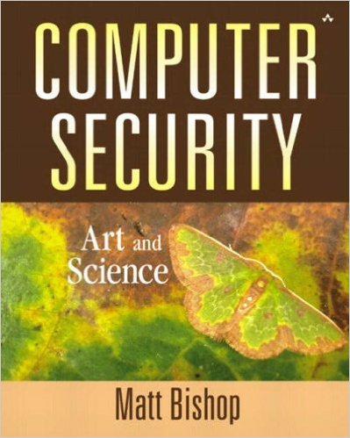
Computer and Network Security COMP 5370/637* Lecture #12 September 14, 2015
Tony Skjellum
skjellum@auburn.edu

Slide 2
Today’s Topics
Security Architectures and Models
Ref: http://www.slideshare.net/7wounders/3-security-architecture-and-models

Slide 3
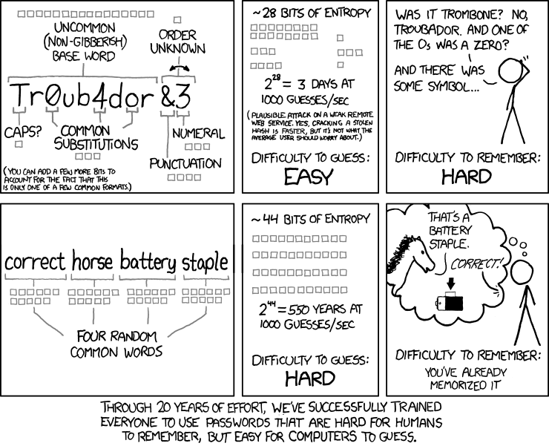
Non-Dilbert Security!

Slide 4
Security Architecture and Models
Security models in terms of confidentiality, integrity, and information flow
Differences between commercial and government security requirements
The role of system security evaluation criteria such as TCSEC, ITSEC
Security practices for the Internet (IETF IPSec)
Technical platforms in terms of hardware, firmware, and software
System security techniques in terms of preventative, detective, and corrective controls

Slide 5
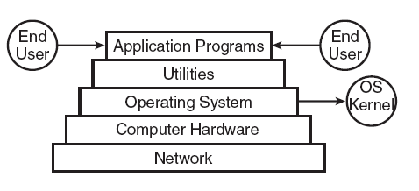
The Layered Approach

Slide 6
General Operating System Protection
User identification and authentication
Mandatory access control
Discretionary access control
Complete mediation
Object reuse protection
Audit
Protection of audit logs
Audit log reduction
Trusted path
Intrusion detection

Slide 7
Network Protection
Hash totals
Recording of sequence checking
Transmission logging
Transmission error correction
Invalid login, modem error, lost connections, CPU failure, disk error, line error, etc.
Retransmission control

Slide 8
The BIG Three
Confidentiality
Unauthorized users cannot access data
Integrity
Unauthorized users cannot manipulate/destroy data
Availability
Unauthorized users cannot make system resources unavailable to legitimate users

Slide 9
Security Models
Bell-LaPadula
Biba
Clark & Wilson
Non-interference
State machine
Access Matrix
Information flow

Slide 10
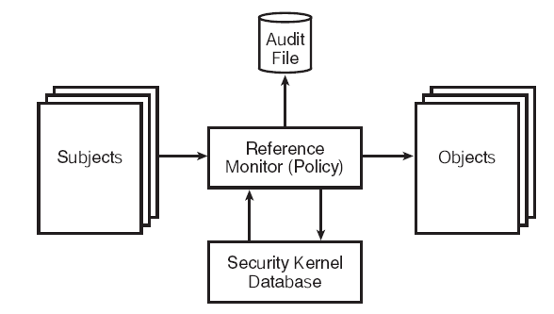
The Security Kernel

Slide 11
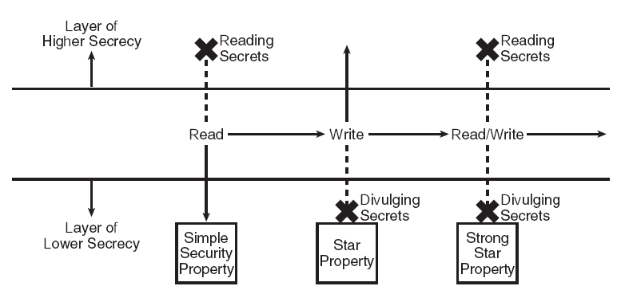
Bell-LaPadula
A state machine model capturing the confidentiality aspects of access control

Slide 12
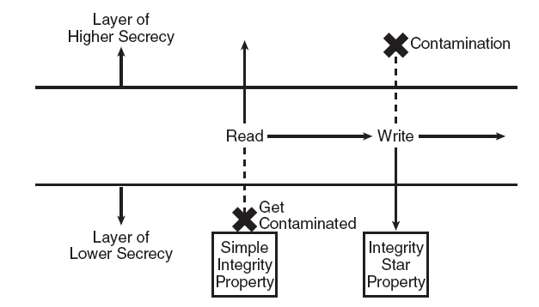
Biba Integrity Model
The Biba integrity model mathematically describes read and write restrictions based on integrity access classes of subjects and objects (Biba used the terms “integrity level” and “integrity compartments”)

Slide 13
Integrity Policy
Given
X: set of entities
I: information
I has integrity property with respect to X if all x ∈ X trusts information in I
Types of integrity:
data integrity: trust I and its conveyance
origin integrity: trust source of I
assurance: I functions as it should

Slide 14
Requirements of Integrity Policy
Users must use existing production software
They cannot write their own software
Programmers will develop and test programs on a non-production system
Explicit process defines how production data provided for dev
Explicit process defines migration of dev to prod
Process is controlled and audited
Managers and auditors have access to the system state and system logs

Slide 15
Principles of Operation
Separation of duty
multiple step processes should involve multiple people
e.g., separate developer from installer
Separation of function
use systems for intended purpose
e.g., separate prod, test, dev environments
Auditing
provide paper trail to verify proper installation, use
e.g., installation logs
Process Principles
Policy
Training
Definition of tasks
Verification mechanism
Reporting mechanism

Slide 16
Biba Integrity Model
The higher the level, the more confidence
That a program will execute correctly
That data is accurate and/or reliable
Example levels (LOCUS OS):
credibility rating based on estimate of software’s trustworthiness (0 untrusted, n highly trusted)
Process has highest credibility level at which it can operate
Explicit run-untrusted command for questionable software

Slide 17
Biba Integrity Model - 2
Definition
Given
Set of subjects S
Set of objects O
Set of integrity levels I
Relation ≤ ⊆ I × I holding when second dominates first
i: S ∪ O → I gives integrity level of entity
Mechanics are similar to Bell-LaPadula model
s ∈ S can read o ∈ O iff i(s) ≤ i(o)
s ∈ S can write to o ∈ O iff i(o) ≤ i(s)
s₁ ∈ S can execute s₂ ∈ S iff i(s₂) ≤ i(s₁)
Compartments and discretionary controls can be added to get full dual of Bell-LaPadula model

Slide 18
Clark-Wilson Integrity Model, 0
Rule-based integrity
Data in a consistent state when rules are satisfied
Example: Bank
D today’s deposits, W withdrawals, YB yesterday’s balance, TB today’s balance
Integrity rule: TB = YB + D – W
Mechanism
CDIs: constrained data items
Data subject to integrity controls
UDIs: unconstrained data items
Data not subject to integrity controls
TPs: transaction procedures
Procedures that take the system from one valid state to another
IVPs: integrity verification procedures
Rules that test the CDIs conform to the integrity constraints
Issues
Certification
Complexity
Notes:
ß

Slide 19
Clark-Wilson Intregrity Model, 1
An Integrity Model, like Biba
Addresses all 3 integrity goals
Prevents unauthorized users from making modifications
Maintains internal and external consistency
Prevents authorized users from making improper modifications
T - cannot be Tampered with while being changed
L - all changes must be Logged
C - Integrity of data is Consistent

Slide 20
Clark-Wilson Model, 2
Proposes “Well Formed Transactions”
perform steps in order
perform exactly the steps listed
authenticate the individuals who perform the steps
Calls for separation of duty
Well-formed transaction - The process and data items can be changed only by a specific set of trusted programs

Slide 21
But …
Suppose you wanted both confidentiality and integrity

Slide 22
Chinese Wall Model
Focus on conflict of interest
Concept:
Suppose
Bubba advises Beauregard Fireworks about inventory
He is asked to advise Opelika Fireworks about inventory
Issue:
Conflict of interest
because his advice for one fireworks stand would affect his advice to the other

Slide 23
Organization
Structure
Entities put into “conflict of interest” classes
Read/write controlled by class
Ensure no flow between subjects/objects
Allow sanitized data to be viewed by everyone
More formally
Objects: items of information related to a company
CD(O): objects related to a single company data set
COI(O): datasets of companies in competition
Assume: each object belongs to exactly one COI class

Slide 24
Example
Bank COI Class
Gasoline Company COI Class
Bank of
America
Shell Oil
Standard Oil
Citibank
Bank of the
W
est
Union ’76
ARCO
If Bubba reads any CD in a COI, he can never read another CD in that COI
Possible that information learned earlier may allow him to make decisions later

Slide 25
Chinese Wall
Let PR(S) be set of objects that S has already read
s can read o iff either condition holds:
There is an o′ such that s has accessed o′ and CD(o′) = CD(o)
Meaning s has read something in o’s dataset
For all o′ ∈ O, o′ ∈ PR(s) ⇒ COI(o′) ≠ COI(o)
Meaning s has not read any objects in o’s conflict of interest class
Initially, PR(s) = ∅, so initial read request granted

Slide 26
Clinical Information Systems Security
Intended for collaborative data (such as medical records)
Conflict of interest not critical problem
Patient confidentiality, authentication of records and annotators, and integrity are
Entities:
Patient: subject of medical records (or agent)
Personal health information: data about patient’s health or treatment enabling identification of patient
Clinician: health-care professional with access to personal health information while doing job

Slide 27
Access
Principle 1: Each patient record has an access control list
Principle 2: One clinician designated to control access control list
Principle 3: Patient is informed of access control list
Principle 4: Access is recorded

Slide 28
Transactions
Add: A clinician may open a record, with the clinician and the patient on the access control list. If a record is opened as a result of a referral, the referring clinician may also be on the access control list.
Delete: Clinical information cannot be deleted from a medical record until the appropriate time has passed.

Slide 29
Transactions
Confine: Information from one medical record may be appended to a different medical record iff the access control list of the second record is a subset of the access control list of the first.
Aggregate: Measures for preventing aggregation of patient data must be effective.
Danger Will Robinson

Slide 30
Other Hybrid Models
Originator Controlled Access
Information i cannot be released to subjects acting on behalf of other organizations without originator's permission; and
Any copies of i must have the same restrictions placed on it.
Rule-based Access
Access depends on function, not identity

Slide 31
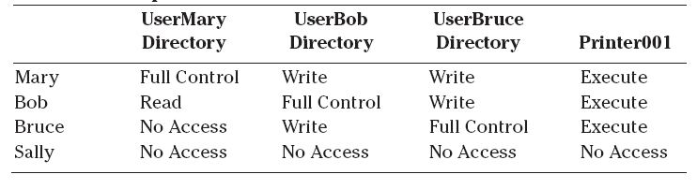
More Models
Access matrix model - A state machine model for a discretionary access control environment
Information flow model - simplifies analysis of covert channels
A variant of the access control model
Attempts to control the transfer of information from one object into another object
helps to find covert channels

Slide 32
More Models Cont…
Noninterference model - Covers ways to prevent subjects operating in one domain from affecting each other in violation of security policy
State machine model - Abstract mathematical model consisting of state variables and transition functions
Chinese Wall Model – provides a model for access rules in a consultancy business where analysts have to make sure that no conflicts of interest arise
Lattice Model - The higher up in secrecy, the more constraints on the data; the lower in secrecy, the less constraints on the data

Slide 33
Certification & Accreditation
Procedures and judgements to determine the suitability of a system to operate in a target operational environment
Certification considers system in operational environment
Accreditation is the official management decision to operate a system

Slide 34
Network/Host Security Concepts
Security Awareness Program
CERT/CIRT
Errors of omission vs. correction
physical security
dial-up security
Host vs. network security controls
Wrappers
Fault Tolerance

Slide 35
IPSEC
IETF updated 1997, 1998
Addresses security at IP layer
Key goals:
authentication
encryption
Components
IP Authentication Header (AH)
Encapsulating Security Payload (ESP)
Both are vehicles for access control
Key management via ISAKMP

Slide 36
TEMPEST
Electromagnetic shielding standard
Mostly for DoD communication Equipments
Currently not widely used
See “accreditation” - i.e. acceptance of risk

Slide 37
Trusted Computing Base (TCB)
The trusted computing base (TCB) of a computer system is the set of all hardware, firmware, and/or software components that are critical to its security, in the sense that bugs or vulnerabilities occurring inside the TCB might jeopardize the security properties of the entire system.
https://en.wikipedia.org/wiki/Trusted_computing_base

Slide 38
Trusted Computing System Evaluation Criteria (TCSEC)
Policy
Accountability
Assurance
Documentation
https://en.wikipedia.org/wiki/Trusted_Computer_System_Evaluation_CriteriaTrusted_Computer_System_Evaluation_Criteria

Slide 39
TCSEC - Policy
Mandatory Security Policy
Marking
Discretionary Security Policy

Slide 40
TCSEC - Accountability
Identification
Authorization
Auditing

Slide 41
TCSEC - Assurance
Assurance Mechanisms
Life-Cycle Assurance
Continuous Protection Assurance

Slide 42
TCSEC - Documentation
User, Trusted Facility, and Test and Design Documentation

Slide 43
TCB Levels (from TCSEC)
D - Minimal protection
C - Discretionary Protection
C1 cooperative users who can protect their own info
C2 more granular DAC, has individual accountability
B - Mandatory Protection
B1 Labeled Security Protection
B2 Structured Protection
B3 Security Domains
A - Verified Protection
A1 Verified Design

Slide 44
Key Points
Basic functions of security
confidentiality, integrity, availability
Terminology
threat, attack, policy, mechanism, assurance
Protecting access
access control matrix
Security Policies
Confidentiality Policies
Bell-LaPadula Model
Integrity Policies
Biba, Clark-Wilson
Hybrid Policies
Chinese Wall, CISS
Hybrid Models
TCSEC, TCB
IPSEC

Slide 45
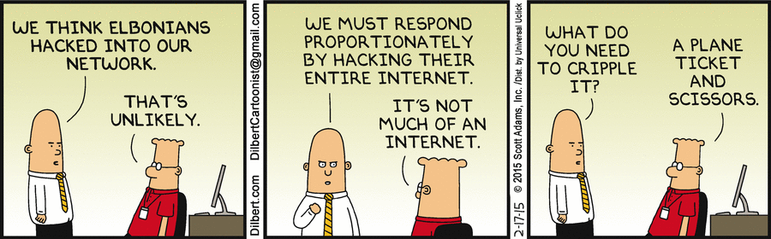
Final thoughts for today
http://dilbert.com/search_results?terms=Hacker

Slide 46
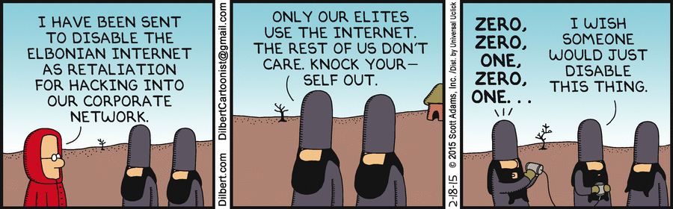
Final thoughts for today
http://dilbert.com/search_results?terms=Hacker

Slide 47
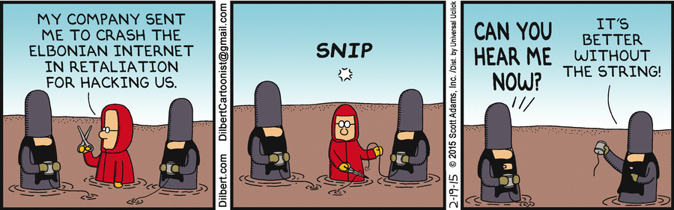
Final thoughts for today
http://dilbert.com/search_results?terms=Hacker

Slide 48
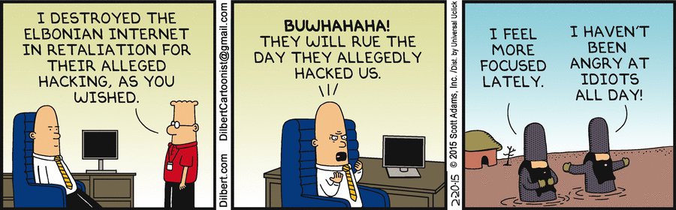
Final thoughts for today
http://dilbert.com/search_results?terms=Hacker

Slide 49
BACKUP

Slide 50
The Architectures
Platform Architecture
Operating System Software and Utilities
Central Processing Unit (CPU) States
Memory Management Overview
Input/Output Devices
Storage Devices
Operating System
Multitasking - Systems allow a user to perform more than one computer Task, such as the operation of an application program at the same time
Multithreading - The ability of a program or an operating system process to manage its use by more than one user at a time and to even manage multiple requests by the same user without having to have multiple copies of the programming running in the computer

Slide 51
The Architectures, 2
Operating System
Multiprogramming system - System that allows for the interleaved execution of two or more programs by a processor
Multiprocessing - The coordinated processing of two or more programs by a processor that contains parallel processors
CPU States
Run - The CPU is executing instructions for the current process
Wait - The process is waiting for a defined event to occur, such as retrieving data from a hard disk
Sleep - The process is suspended and waiting for its next time slice in the CPU, or a given event to occur such as an alarm
Masked/interruptible state - Interrupts are implemented to allow system events to be synchronized. For example, if the masked bit is not set, the interruption is disabled (masked off)

Slide 52
The Architectures, 3
Memory
Random Access Memory (RAM)
Dynamic Random Access Memory (DRAM)
Extended Data Output RAM (EDO RAM)
Synchronous DRAM (SDRAM)
Double Data Rate SDRAM (DDR SDRAM)
Burst Extended Data Output DRAM (BEDO DRAM)
Read-Only Memory (ROM)
Programmable Read-Only Memory (PROM)
Erasable and Programmable Read-Only Memory (EPROM)
Electrically Erasable Programmable Read-Only Memory (EEPROM)
Flash Memory

Slide 53
The Architectures, 4
Storage
Primary - Main memory directly accessible to the CPU
Secondary - Nonvolatile storage medium
Real - A program is given a definite storage location in memory
Virtual - The ability to extend the apparent size of RAM
Volatile - RAM
Nonvolatile – ROM and Secodary storage devices
Write-Once Read Memory -

Slide 54
The Architectures, 5
Network Environment - A data communication system allowing a number of devices to communicate with each other
Local Environment
Shared Environment
Security Environments
Dedicated security mode -processing of one particular type or classification of information
System high-security mode – system hardware/software is only trusted to provide need-to-know protection between users
Multi-level security mode - allows two or more classification levels
Controlled mode - type of multi-level security in which a more limited amount of trust
Compartmentalized security mode - process two or more types of compartmented information
Enterprise Architecture - Systematically derived and captured structural descriptions

Slide 55
Related Definitions
Access control - Prevention of unauthorized use or misuse of a system
ACL - Access control list
Access Mode - An operation on an object recognized by the security mechanisms - think read, write or execute actions on files
Accountability- Actions can be correlated to an entity
Accreditation - Approval to operate in a given capacity in a given environment
Asynchronous attack - An attack exploiting the time lapse between an attack action and a system reaction

Slide 56
Related Definitions. 2
Audit trail - Records that document actions on or against a system
Bounds Checking - Within a program, the process of checking for references outside of declared limits. When bounds checking is not employed, attacks such as buffer overflows are possible
Compartmentalization - Storing sensitive data in isolated blocks
Configuration Control - management and control of changes to a system’s hardware, firmware, software, and documentation
confinement - Ensuring data cannot be abused when a process is executing a borrowed program and has some access to that data

Slide 57
Related Definitions, 3
Contamination – Corruption of data of varying classification levels
Correctness Proof - Mathematical proof of consistency between a specification and implementation
Countermeasure - anything that neutralizes vulnerability
Covert Channel - A communication channel that allows cooperating processes to transfer information in a way that violates a system’s security policy
covert storage channel involves memory shared by processes
covert timing channel involves modulation of system resource usage (like CPU time)

Slide 58
Related Definitions, 4
Criticality - Importance of system to mission
Cycle - One cycle consists of writing a zero, then a 1 in every possible location
Data Contamination - Deliberate or accidental change in the integrity of data
Discretionary Access Control - An entity with access privileges can pass those privileges on to other entities
Mandatory Access control - Requires that access control policy decisions are beyond the control of the individual owner of an object (think military security classification)

Slide 59
Related Definitions, 5
DoD Trusted Computer System Evaluation Criteria (TCSEC) - orange book
Firmware - software permanently stored in hardware device (ROM, read only memory)
Formal Proof - Mathematical argument
Hacker/Cracker – Individual who cause Damage
Logic bomb - An unauthorized action triggered by a system state
Malicious logic - Evil hardware, software, or firmware included by malcontents for malcontents

Slide 60
Related Definitions, 6
Principle of Least Privilege - Every entity granted least privileges necessary to perform assigned tasks
Memory bounds - The limits in a range of storage addresses for a protected memory region
Piggy Back - Unauthorized system via another’s authorized access (shoulder surfing is similar)
Privileged Instructions - Set of instructions generally executable only when system is operating in executive state
Reference Monitor - A security control which controls subjects’ access to resources - an example is the security kernel for a given hardware base

Slide 61
Related Definitions, 7
Resource - Anything used while a system is functioning (eg CPU time, memory, disk space)
Resource encapsulation - Property which states resources cannot be directly accessed by subjects because subject access must be controlled by the reference monitor
Security Kernel - Hardware/software/firmware elements of the Trusted Computing Base - security kernel implements the reference monitor concept
Trusted Computing Base - From the TCSEC, the portion of a computer system which contains all elements of the system responsible for supporting the security policy and supporting the isolation of objects on which the protection is based -follows the reference monitor concept

Slide 62
Related Definitions, 8
TCSEC - Trusted Computer Security Evaluation Criteria - Evaluation Guides other than the Orange Book
ITSEC - Information Technology Security Evaluation Criteria (European)
CTCPEC - Canadian Trusted Computer Product Evaluation Criteria
CC - Common Criteria

Slide 63
Related Definitions, 9
Trusted System
follows from TCB
A system that can be expected to meet users’ requirements for reliability, security, effectiveness due to having undergone testing and validation
System Assurance
the trust that can be placed in a system, and the trusted ways the system can be proven to have been developed, tested, maintained, etc.

Slide 64
Related Definitions, 10
Virus - program that can infect other programs
Worm - program that propagates but doesn’t necessarily modify other programs
Bacteria or rabbit - programs that replicate themselves to overwhelm system resources
Back Doors - trap doors - allow unauthorized access to systems
Trojan horse - malicious program masquerading as a benign program

